Slide 1
Hansruj Bnanji Wholesalers Online Purchasing System
Project presentation
by
William c. Lubaini

Slide 2
System Outline
Introduction
Aim of the system
Objective
Functionality of the system
Required Resources
Project Schedule
Conclusion

Slide 3
Introduction
The system will be used for purchasing online and storing information of the company by developing a website and a modern database system.

Slide 4
Aims of the system:
To make the process of buying and selling of goods more efficiency.

Slide 5
Objective:
To develop a database driven website that should be able to allow customers to purchase online and should be able to store their information automatically in the database.

Slide 6
Functionalities of the system
Customers will be able to create account.
Customers will be able to add to shopping cart their goods.
Customers will be able to choose a payment method.
Customers will be able to choose date and time to deliver their goods.
Database system will be able to store information automatically.

Slide 7
Required Resource
One Laptop
XAMPP server
One Web Browser such as Chrome or Mozilla Firefox
PHP
HTML5, CSS3, JQuery, Bootstrap and JavaScript

Slide 8
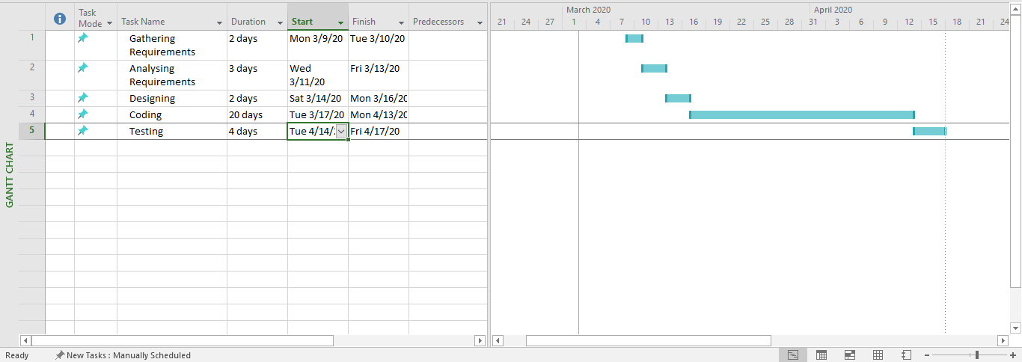
Project Schedule

Slide 9
Conclusion
The system will help the company to make the process of buying and selling goods more efficiency and the system will eradicate problems that the company is facing now.

Slide 10
Hansruj Bnanji Wholesalers Online Purchasing System
Prepared By William C. Lubaini

